Slide 1

The VVAD-LRS3 Dataset for Visual Voice Activity Detection
University of Bremen
Robotics Research Group
A large scale dataset for Visual Voice Activity Detection
Adrian Lubitz
Notes:
Hi, my name is Adrian :)
Thank you for your interest

Slide 2

The VVAD-LRS3 Dataset for Visual Voice Activity Detection
Adrian Lubitz
University of Bremen
Robotics Research Group
Overview
Motivation
Implementation
Evaluation
Interpretation
Questions & Ideas
Notes:
Motivation
Implementation
Evaluation
Interpretation
Questions & Ideas

Slide 3
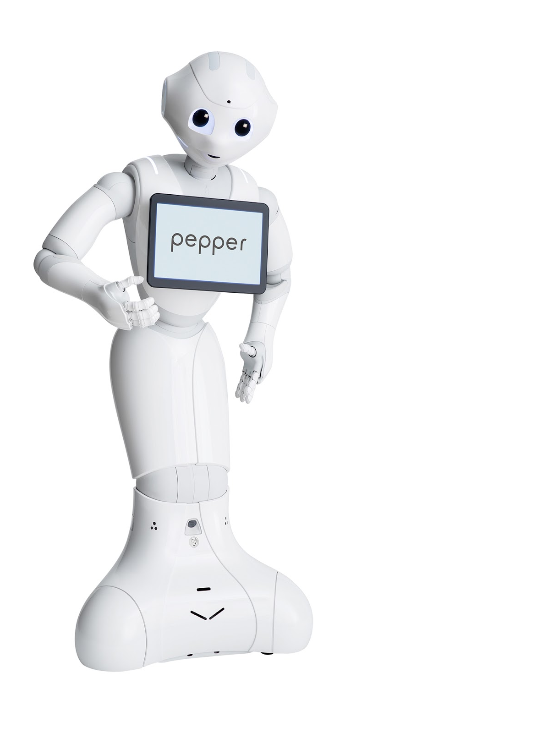
The VVAD-LRS3 Dataset for Visual Voice Activity Detection
Adrian Lubitz
University of Bremen
Robotics Research Group
Motivation
What is Visual Voice Activity Detection
Why do we need it?
Notes:
What is Visual Voice Activity Detection
Detects if someone is speaking solely on visual input
Just like humans do in Video Conferences
Why do we need it?
Pepper is the motivation
Interaction as natural as possible
Think about how to Start of a Conversation, raising attention
Stimulus (AUDITORY, TACTILE, VISUAL)
1 Person scenario vs. crowded and noisy
Stare detection in noisy environments
Speaker detection for multiple people in field of view
Trend is Huge Models for multi modal and multi task learning – cool but mostly not deployable on robots with limited computing capabilities

Slide 4
The VVAD-LRS3 Dataset for Visual Voice Activity Detection
Adrian Lubitz
University of Bremen
Robotics Research Group
Implementation
Dataset creation
Model training
Notes:
Automatically anotated Dataset Creation
Implementation of the Learning Algorithms

Slide 5
The VVAD-LRS3 Dataset for Visual Voice Activity Detection
Adrian Lubitz
University of Bremen
Robotics Research Group
Dataset creation – what do we have?
LRS3 Dataset
Text: EVEN DREAMED OF MEAN HERE YOU HAVE THESE GUYS WHO BASICALLY THOUGHT THEY WERE JUST FOLLOWING THIS HUNCH THIS LITTLE PASSION THAT HAD DEVELOPED THEN THEY THOUGHT THEY WERE FIGHTING THE COLD WAR
Conf: 4
Ref: 0af00UcTO-c
FRAME X Y W H
025877 0.294 0.111 0.166 0.416
025878 0.294 0.118 0.164 0.403
025879 0.294 0.117 0.165 0.408
025880 0.300 0.126 0.157 0.402
. . .
WORD START END ASDSCORE
EVEN 0.07 0.26 6.2
DREAMED 0.26 0.53 5.5
OF 0.53 0.66 4.1
MEAN 0.69 0.85 3.3
. . .
Notes:
LRS3
Over a 100 thousand utterances from TED and TEDx talks - DIVERSITY
Utterance
Ref - Youtube reference of TED and TEDx Talks
Frame - Start bounding box
Timing of words - when is the person speaking and when is the person not speaking

Slide 6
The VVAD-LRS3 Dataset for Visual Voice Activity Detection
Adrian Lubitz
University of Bremen
Robotics Research Group
Dataset creation – what do we want?
Samples for Visual Voice Activity Detection
Binary labels
k frames
Notes:
Binary Labels - speaking and not speaking
k Frames - k needs to big enough to make robust predictions but small enough to be fast

Slide 7
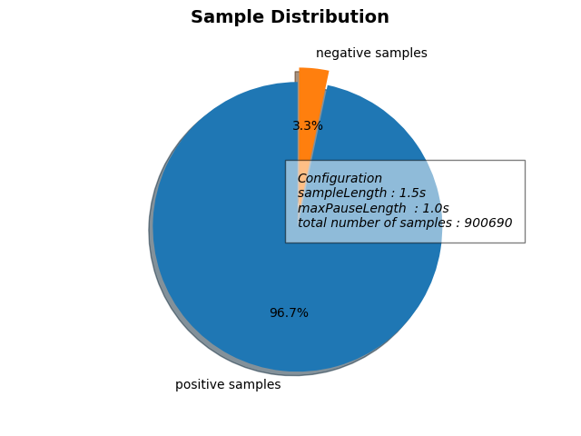
The VVAD-LRS3 Dataset for Visual Voice Activity Detection
Adrian Lubitz
University of Bremen
Robotics Research Group
Dataset creation – what do we do?
Download all videos from YouTube
Extract positive and negative samples
Face Detection & Object Tracking
Generate Features
Notes:
Download all Videos from Youtube
Wrote a little script for that and adjust of framerate - takes ~500GB
Extract positive and negative samples
On text level(frame numbers)
LRS3 is only bound to max words and scene change
Pauses in speech can be used as negative samples
Face Detection & Object Tracking
Detect face in the given bounding box - follow it over frames
Generate Features
Face Images, Lip Images, Facial Features (Dlib’s shape predictor ) - XXX for Face and XXX for the lips

Slide 8
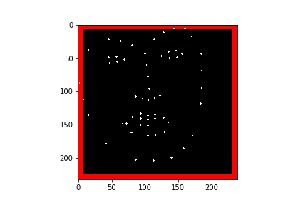
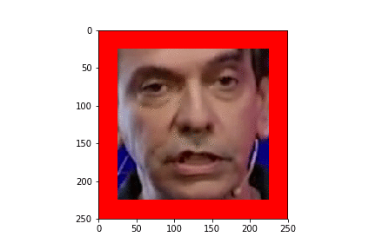
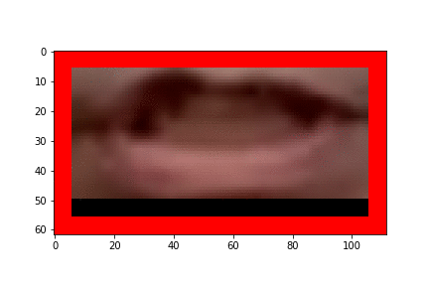
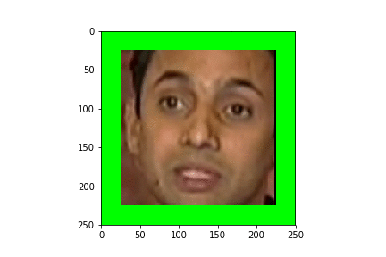
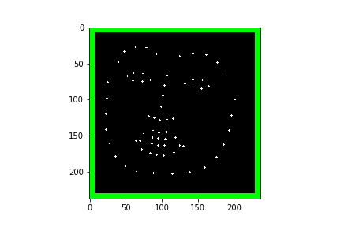
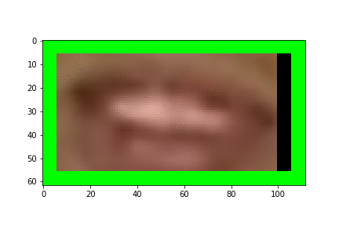
The VVAD-LRS3 Dataset for Visual Voice Activity Detection
Adrian Lubitz
University of Bremen
Robotics Research Group
Dataset creation – what do we get?
Notes:
44490 samples in a 1-to-1 ratio
Approaches
End-To-End learning with frames of the whole face
End-To-End learning with frames of the lips
Feature engineered approach with facial features of the whole face
Feature engineered approach with facial features of the lips
TODO: lip features viz

Slide 9
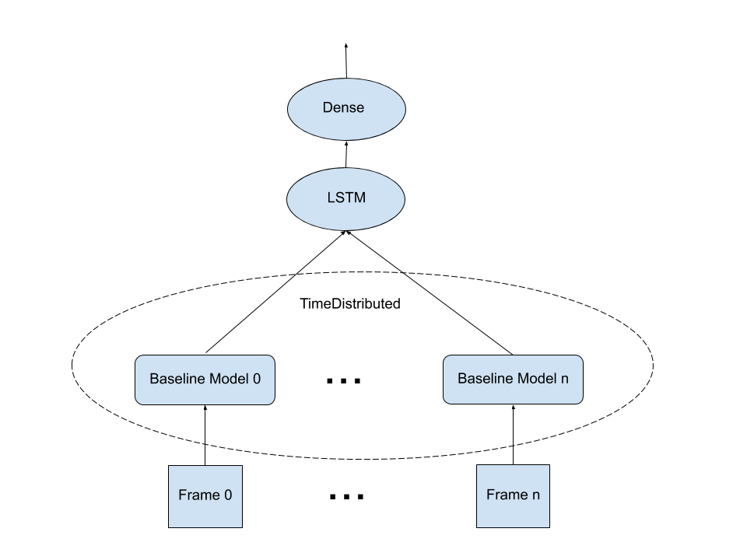
The VVAD-LRS3 Dataset for Visual Voice Activity Detection
Adrian Lubitz
University of Bremen
Robotics Research Group
Model training
End-To-End
Baseline Model for spatial features
TimeDistributed over n Frames
LSTM models temporal dependencies
Dense Layer for the classification
Notes:
End-To-End(Structure is the same for Face and lips - model size is drastically different)
Baseline Model for spatial features
Tried different models that performed well on the imageNet dataset - took mobilenet in the end
TimeDistributed over n Frames
For every frame a baseline model is used - can get very big fast
LSTM for temporal dependencies
State of the art for timeseries
Dense Layer for the classification

Slide 10
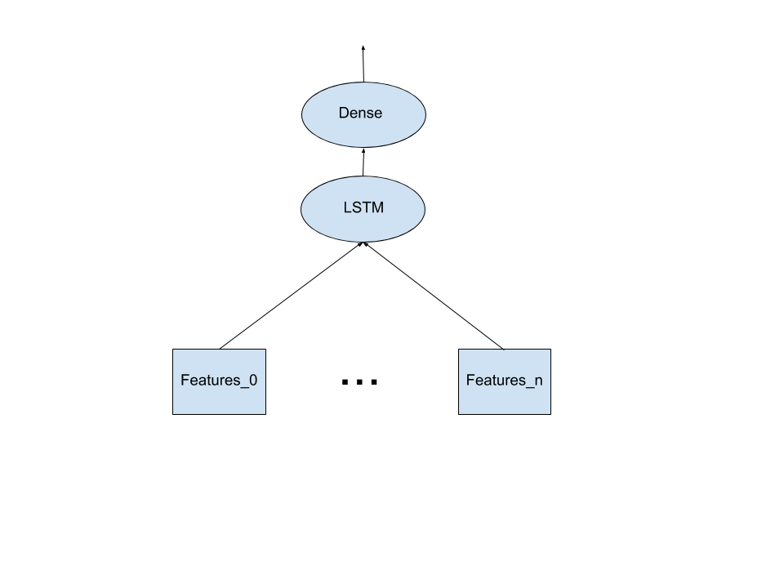
The VVAD-LRS3 Dataset for Visual Voice Activity Detection
Adrian Lubitz
University of Bremen
Robotics Research Group
Model training
Facial Features
Features coming from Dlib’s facial landmark detector
No need for a timeDistributed Wrapper
Top of the model structure stays the same
Notes:
Facial Features(The same structure for face and lips)
Features coming from Dlib’s facial landmark detector
No need for a timeDistributed Wrapper
Makes the model smaller - production of the spatial features is outside the model
Top of the model structure stays the same
Shows how deep learning can replace feature engineering

Slide 11
The VVAD-LRS3 Dataset for Visual Voice Activity Detection
Adrian Lubitz
University of Bremen
Robotics Research Group
Evaluation
Human Accuracy Test
Baseline Models
Evaluation of image size
Evaluation of used frames
Evaluation of the End-To-End Approach
Evaluation of the Facial Features Approach
Notes:
Human Accuracy Test
Baseline Models
Evaluation of image size
Evaluation of used frames
Evaluation of the End-To-End Approach
Evaluation of the Facial Features Approach

Slide 12
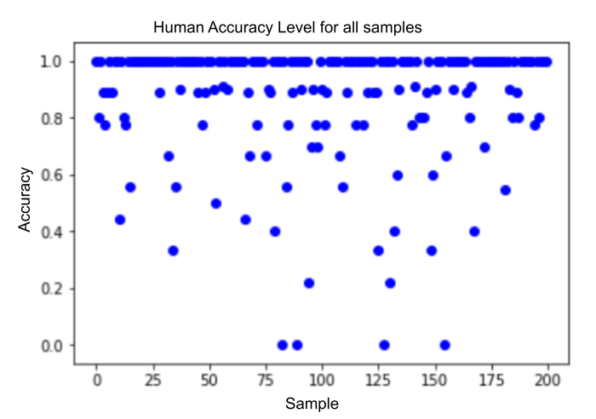
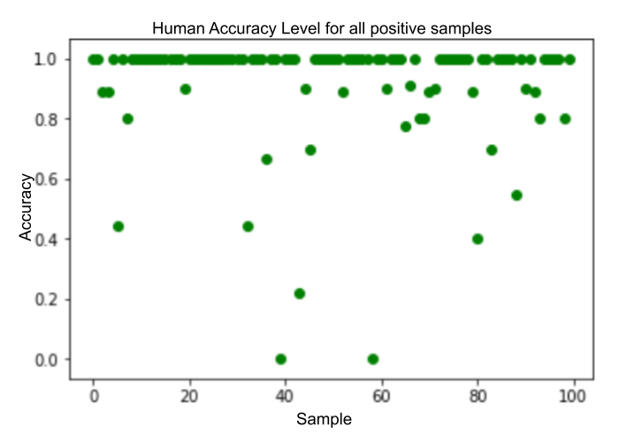
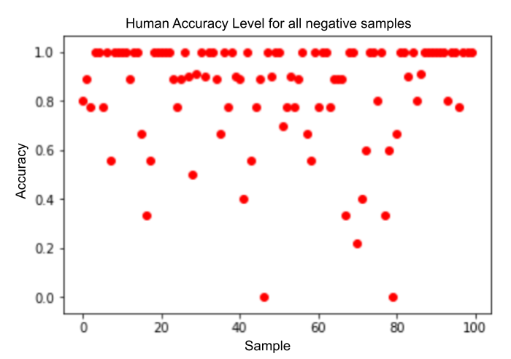
The VVAD-LRS3 Dataset for Visual Voice Activity Detection
Adrian Lubitz
University of Bremen
Robotics Research Group
Human Accuracy Test
Average Accuracy: 87.93%
Average Accuracy for positive Samples: 91.44%
Average Accuracy for negative Samples: 84.44%
Notes:
Conducted on 10 persons
100 positive and 100 negative samples
Proofs the dataset is suitable for the problem
Shows that negative samples are harder to produce from the LRS3
Obviously some wrong labeled samples

Slide 13
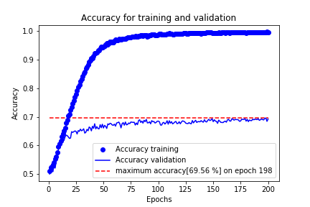
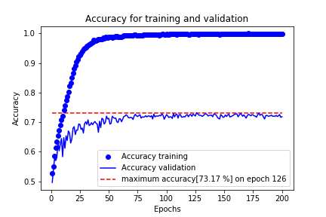
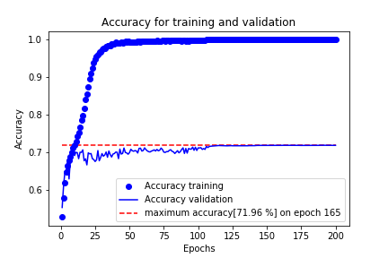
The VVAD-LRS3 Dataset for Visual Voice Activity Detection
Adrian Lubitz
University of Bremen
Robotics Research Group
Baseline models
MobileNet
DenseNet
VGGFace
Notes:
One image classified by well known models(have good results on the imageNet)
With ImageSize 96x96 pixels
Accuracy cant go much higher than 70%
Size of the model doubles
Decided to go with mobileNet because of the size - DenseNet wasn’t trainable for more than 4 timesteps

Slide 14
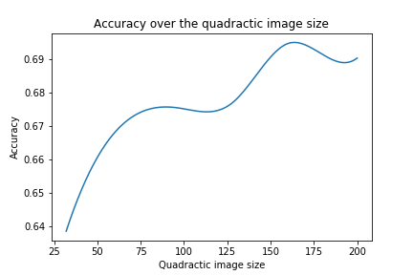
The VVAD-LRS3 Dataset for Visual Voice Activity Detection
Adrian Lubitz
University of Bremen
Robotics Research Group
Evaluation of image size
Notes:
On mobileNet Baseline model
only exploiting the spatial features
160*160 is apparently the best image size

Slide 15
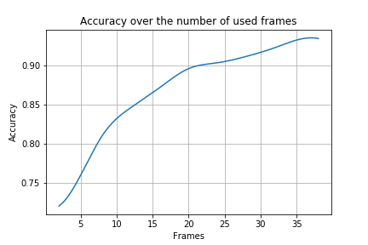
The VVAD-LRS3 Dataset for Visual Voice Activity Detection
Adrian Lubitz
University of Bremen
Robotics Research Group
Evaluation of used frames
Notes:
timeDistributed mobileNet
Exploiting temporal features
Already reaches up to 90% for under a second(with respect to human accuracy this is very good)

Slide 16
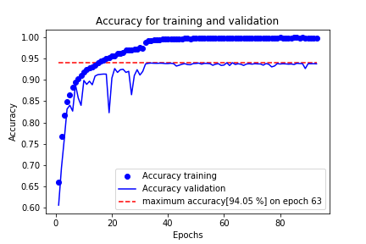
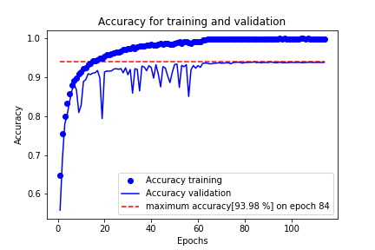
The VVAD-LRS3 Dataset for Visual Voice Activity Detection
Adrian Lubitz
University of Bremen
Robotics Research Group
Evaluation of the End-To-End Approach
Faces
Lips
Notes:
Accuracy on training and validation data

Slide 17
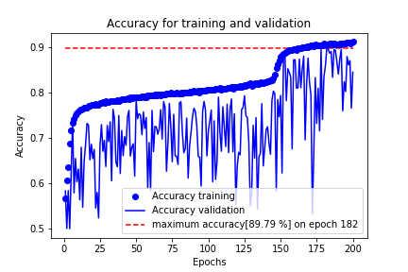
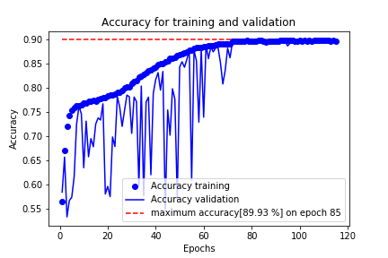
The VVAD-LRS3 Dataset for Visual Voice Activity Detection
Adrian Lubitz
University of Bremen
Robotics Research Group
Evaluation of the Facial Features Approach
Faces
Lips
Notes:
Accuracy on training and validation data

Slide 18
The VVAD-LRS3 Dataset for Visual Voice Activity Detection
Adrian Lubitz
University of Bremen
Robotics Research Group
Interpretation
Model | Accuracy | MAE
Human | 87.93%
Lip Feature | 89.0% | 0.16
Face Features | 89.0% | 0.15
Lip End-To-End | 92.0% | 0.09
Face End-To-End | 92.0% | 0.08
All models reach superhuman performance
VVAD relies mostly on the lips
Deep Learning vs. Feature Engineering
Notes:
All models reach superhuman performance
Can enhance social robots or human-machine interfaces (Was the goal)
VVAD relies mostly on the lips
This knowledge may help to produce smaller models
Deep Learning vs. Feature Engineering
DL is very generic and good results but needs a lot of power(GPU RAM, Time)
FE needs domain knowledge but can be very efficient
DL is less explainable
FE is bound to the assumptions/biases of the designer
SUM IT UP
We created a large scale dataset for VVAD which can help to improve HRI
We showed that robust models with super human performance can be trained on that dataset
TODO: warum kein MAE bei human und warum kann bei Human die Accuracy so einen Kommawert haben und bei den Models nicht?

Slide 19
The VVAD-LRS3 Dataset for Visual Voice Activity Detection
Adrian Lubitz
University of Bremen
Robotics Research Group
Questions & Ideas
Thank you for your attention!
Feel free to ask and comment!
Notes:
Thanks for attention and interest!
Feel free to ask and comment

